Slide 1
CovidA10
Meeting minutes &
Action point slides
Date: 15/05/2022 (Week 12)

Slide 2
Progress and action points (not required for the first meeting)
Action points from last week … …
…
…
Key progress over last week …
…
…

Slide 3
Define your project – What is your question /product
Project: A dashboard to call on the elderly to rationally vaccinated
Question 1: Is there a relationship between age and mortality caused by covid?
Question 2: Is there a relationship between vaccination rate and server COVID-19?
Question 3: Is there a relationship between vaccination rate and mortality?
Question 4: What is relationship between the vaccination rate and age(over 65 years old) ?
Question 5: Is there a relationship between different continents and trend in the number of people with Covid-19 after vaccination?
Question 6: Are vaccination rates associated with cardiovascular mortality?

Slide 4
Define your project – Anticipated challenges
For Project:
Challenge 1: Missing data for plenty of columns
Challenge 2: Unclear data meaning that we do not know the exact meaning of some columns of data, such as age data.

Slide 5
Define your project – who is your target audience
Explore different types of target audience and its relationship to your project and select
the most appropriate.
Target audience | Characteristics of target audience | How does it impact your project
The elderly | The elderly have limited access to Covid-19 and vaccination. | Through the actual feedbacks from the elderly on using the dashboard, it will help us to further improve the project. Better help us know how to publicize among the elderly.
Better help us know how to publicize among the elderly | Having a wide range of information sources makes it easier to accept new knowledge. | They could help us get the information about the old people in the home. Also, they could help us publicize and teach the elderly to watch our dashboard.
Medical staff for the elderly | Better understanding of the physical condition of the elderly. | Help the elderly get vaccinated correctly.

Slide 6
Meeting minutes
Date and time of meeting: 27/02/2022
Team members present: Yunshun Zhang, Kang Fu, Yuxuan Qin, Katherine An, Yachao Zhang
AGENDA
Item | Discussion (you can refer to previous slides) | Actions (who) – action points for next week
Research question | Create some appropriate research question based on the csv date set. | Select the most 4 suitable questions after asking the advise from tutor. —-Yunshuo Zhang, Yuxuan Qin
Assign role | - Team charter: All team - Meeting minutes: All team - Assign the other roles after selecting the appropriate research question | Decide the meeting time. —-Kang fu
Challenges | Discussion the challenges based on the question we raised. | Figure out the methods for solving the challenges —Katherine An, Yachao Zhang
Target audience | Decide the appropriate audience. | Further supplement the relevant information of audience and the relevant impact of our project on audience — Kang fu
Next meeting date and time: 01/04/2022
Group member responsible for finalising/submitting minutes: Katherine An
To be posted on the CANVAS Individual group website

Slide 7
Progress and action points (not required for the first meeting)
Action points from last week … …
- Select the most 4 suitable questions
- Decide the meeting time.
- Figure out the methods for solving the challenges
- Further supplement the relevant information of audience and the relevant impact of our project on audience
Key progress over last week …
Redefine our project
determine the specific target audiance
determine new research questions
…

Slide 8
Define your project – What is your question/product
Project: A dashboard to show the factors around international students that may influence the overseas studying
Question 1: Identify the top 20 countries with the most total cases as our research object.
Question 2: find out if change in government response will affect number of new cases
Question 3: How long does the policy take to work(find out the lag between the government index increase and the new cases decrease.

Slide 9
Define your project – Anticipated challenges
For Project:
Challenge 1: Unclear data meaning that we do not know the exact meaning of some columns of data, such as age data. like,
new_deaths_smoothed, aged_70_older, etc.

Slide 10
Define your project – who is your target audience
Explore different types of target audience and its relationship to your project and select
the most appropriate.
Target audience | Characteristics of target audience | How does it impact your project
policy-making organizations in countries with serious epidemic and researchers who manage policies during the epidemic | They are key people responsible for policy formulation and research | The increase and decrease of restrictive items in their policies have a great impact on the increase of cases

Slide 11
Meeting minutes
Date and time of meeting: 03/04/2022
Team members present: Yunshun Zhang, Kang Fu, Yuxuan Qin, Katherine An, Yachao Zhang
AGENDA
Item | Discussion (you can refer to previous slides) | Actions (who) – action points for next week
Establish Github | determine the project platform for group cooperation | create Github and join every team members —-Yunshuo Zhang
data clean | extract the appropriate data based on the research question | Select the corresponding data columns and do the data cleaning—-Katherine An, Yachao Zhang
determine the time period | choose the appropriate time period based on the date of vaccination occurs | determine an approximate time period to find the vaccination rate—-Kang Fu
Filter the data needed | Filter the data columns we need according to the questions | put the corresponding data columns to the related questions and summay the relationshhip between RQ and topic—Yuxuan Qin
Next meeting date and time: 08/04/2022
Group member responsible for finalising/submitting minutes: Yunshuo Zhang
To be posted on the CANVAS Individual group website

Slide 12
Progress and action points
Action points from last week … …
Discuss and identify the topic study together
Data cleaning for the extra dataset
Initial data analysis
Draw maps and line charts of the first research question
Distance matrix
Shiny initially build and import code
Key progress over last week …
Redefine topic and research questions
Draw the number of total death in the world map
Initially data analysis of total deaths

Slide 13
Developing the project – data
Illustrate progress in data generation or data collection by showing some initial data analysis of your data.
As you can see from the line chart, all the countries show an overall upward trend, there are three countries with the highest growth rates are the United States, India and Brazil, while the rest of the world is experiencing relatively flat growth rates. From January 2020 to April 2020, the stringency _index skyrocketed to nearly 100. Although all countries showed an overall slow decline trend from April 2020, all data showed that index had been in a state of drastic fluctuations and all the numbers are pretty much fixed between 30 and 85. What's special about this chart is that you can always cancel the country lines that don't interest you. Click on individual countries and the chart will not show their data.
We intercepted the total number of cases and stringency index of different countries in 2021-12-31 and presented them on the world map. Through the images, we can find that on 2021-12-31, the number of cases in some regions and countries such as southern Africa, North America, and Europe is relatively high. In addition, the stringency index of some countries and regions in North America, South America, and Asia is higher.
Also, we did the distance matrix to observe the similarity between countries. For the stringency index, based on the distance matrix, the stringency index of Japan and Czechia are quite different from Peru, Philippine， Argentina and India. Furthermore, the stringency index between United Kingdom, Brazil, Spain and United States are similar. For the total cases, United States are pretty different with other countries and the total cases are relatively higher than others.

Slide 14
Developing the project – methods
Proposed analytics or proposed methods.
1. Data visualization:
world map: to show the distribution of the total cases and stringency index in selected countries
Line chart: to show the change trend of the total cases and stringency index over time in selected countries.
2. Distance matrix:
to compute distance matrix between each country stringency index time series Perform hierarchical clustering using distance matrix to find countries with similar stringency index across time.
3.Transition analysis:
to see which country has the most significant change in its stringency index level between 2020 and 2021 and whether this change is positive or negative
4. Shiny

Slide 15
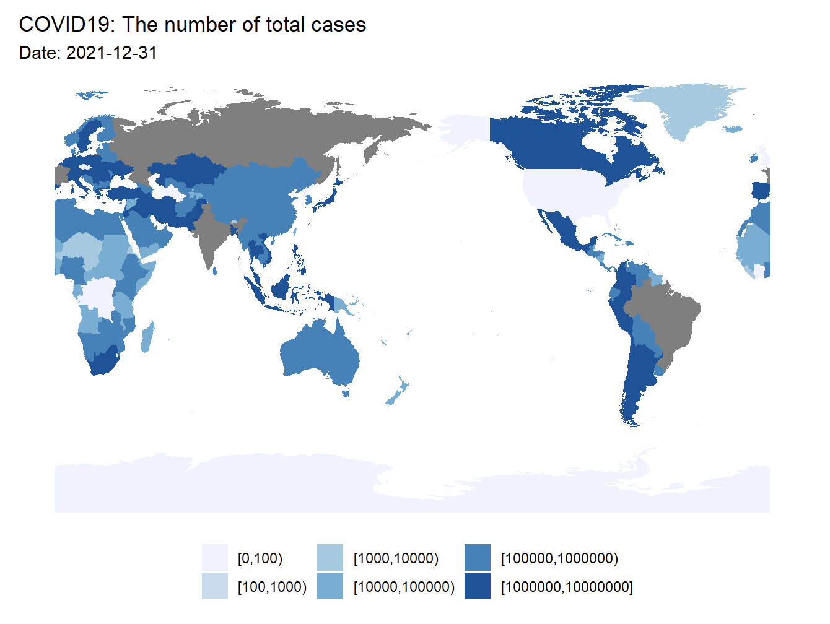
Developing the project – initial evaluation

Slide 16
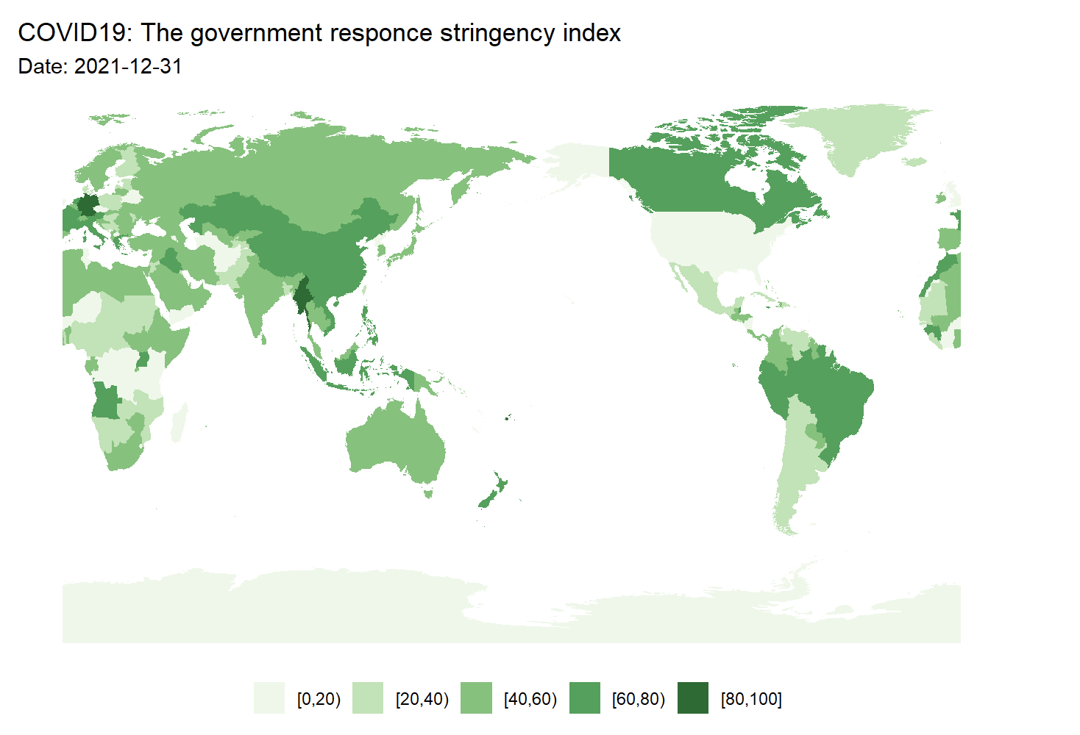
Developing the project – initial evaluation

Slide 17
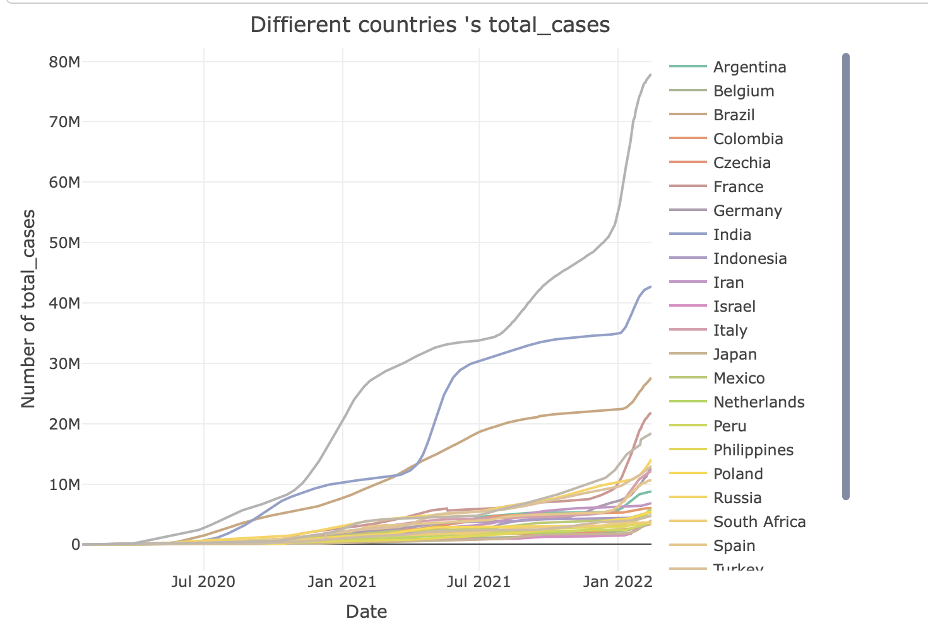
Developing the project – initial evaluation

Slide 18
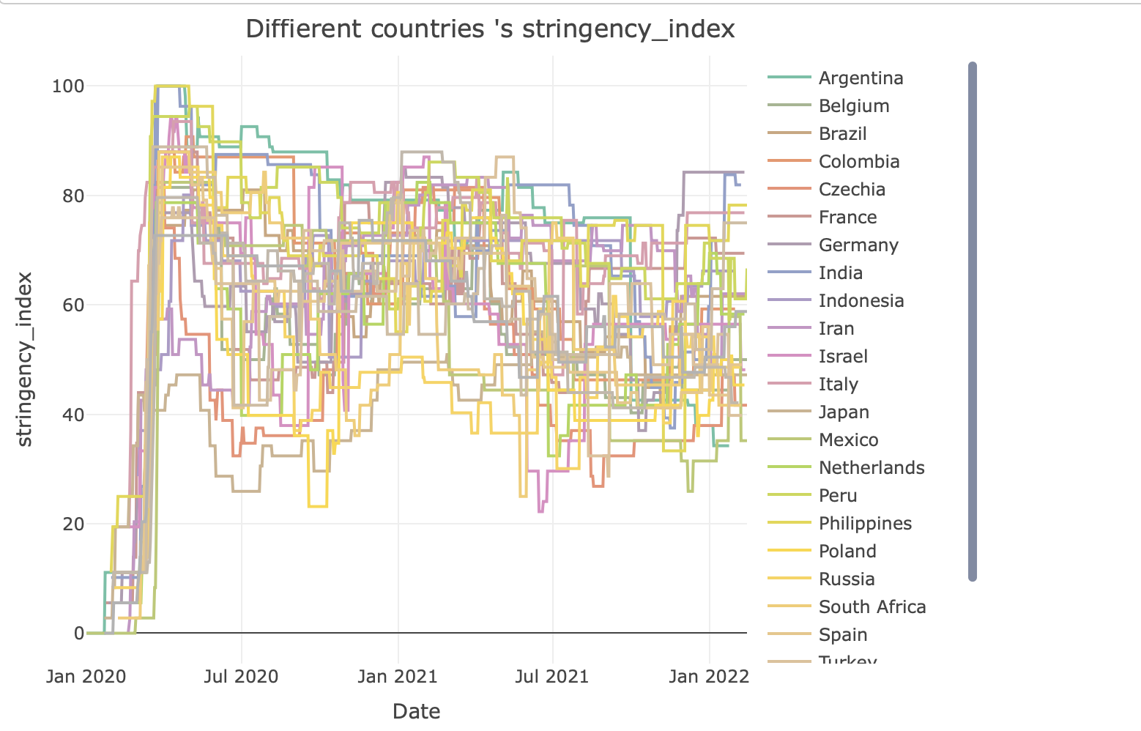
Developing the project – initial evaluation

Slide 19
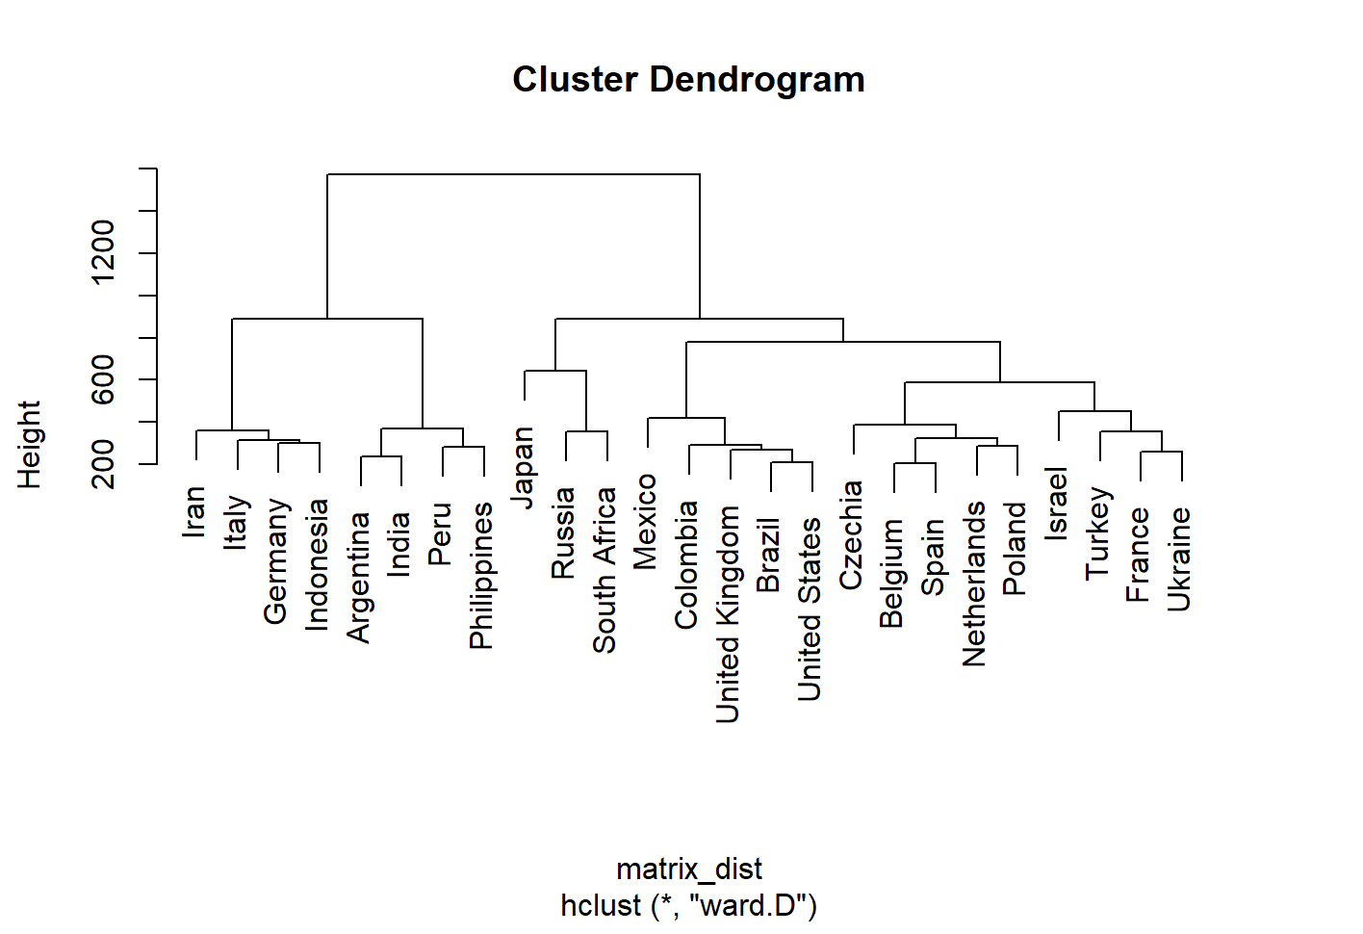
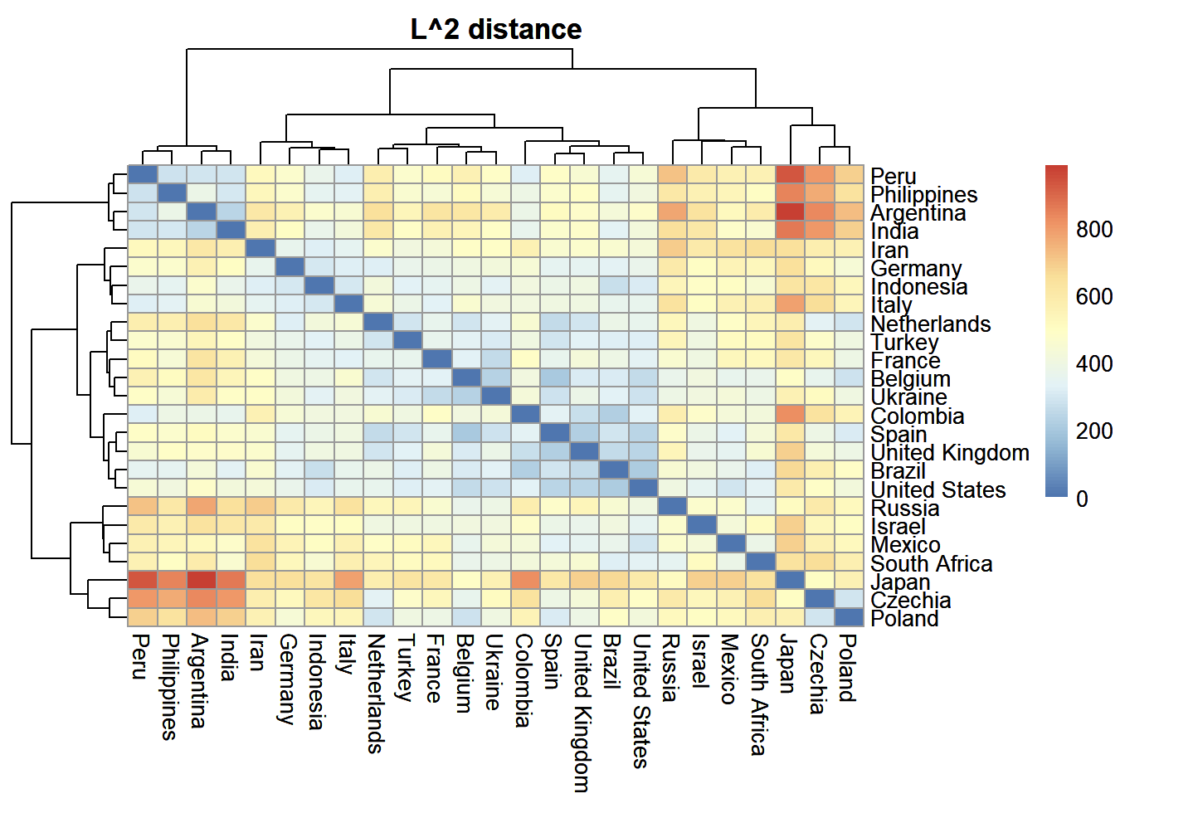
Developing the project – initial evaluation

Slide 20
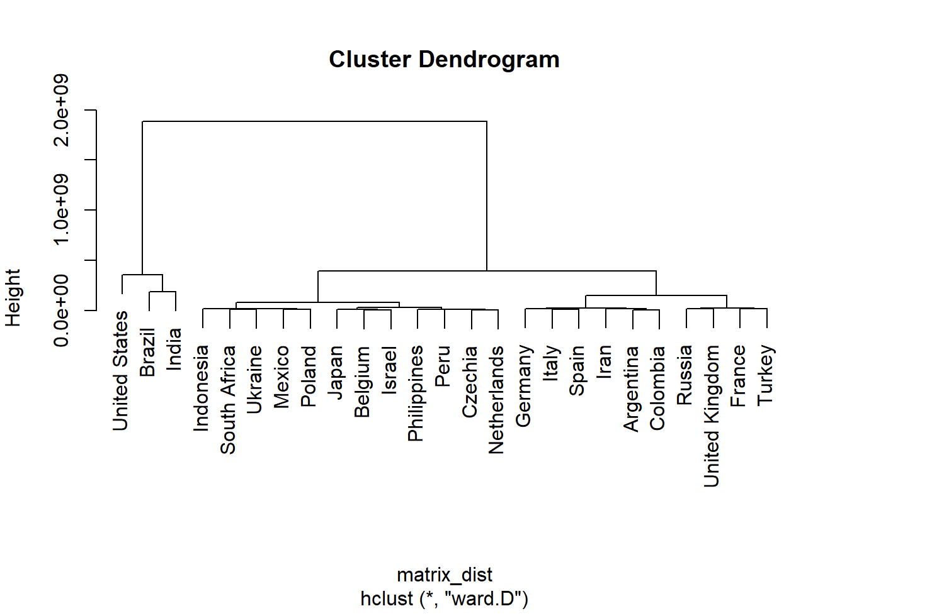
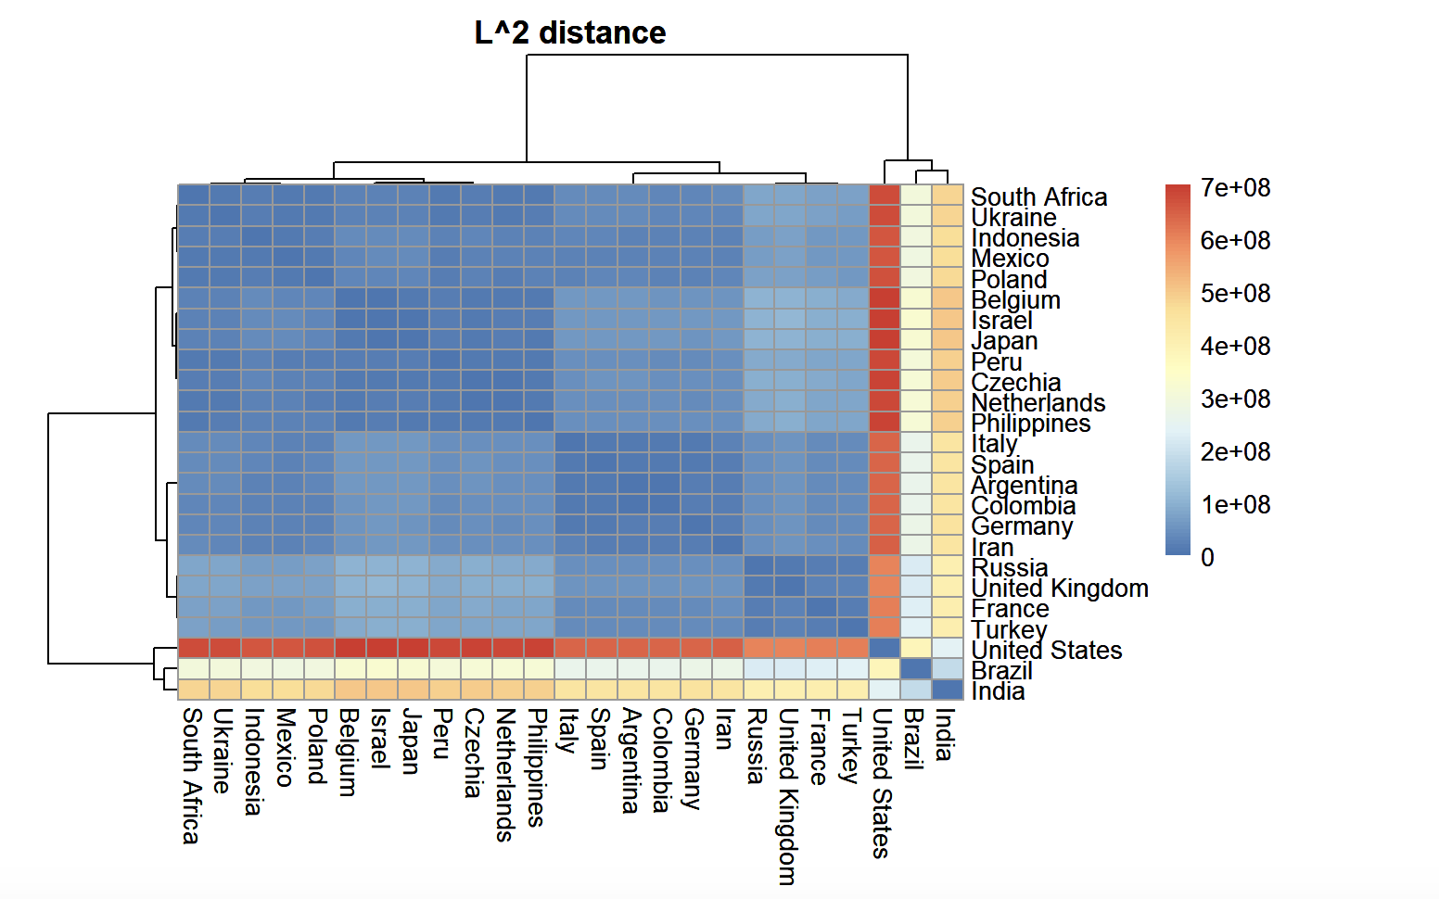
Developing the project – initial evaluation

Slide 21
Meeting minutes
Date and time of meeting: 24/04/2022
Team members present: Yunshun Zhang, Kang Fu, Yuxuan Qin, Katherine An, Yachao Zhang
AGENDA
Item | Discussion (you can refer to previous slides) | Actions (who) – action points for next week
Observe the distribution and trend | Draw maps and line charts of the government response stringency index, total cases, international travel controls, school closing. | Further discussion of the charts and re-draw the maps of international travel controls and school closing - Katherine An, Yachao Zhang
Similarity between countries and transition analysis | Perform hierarchical clustering using distance matrix. | Further analysed the information -- Yunshuo Zhang, Kang Fu
Determine the target audience | Determine the final target audience | -- Katherine An, Yachao Zhang, Yunshuo Zhang, Yuxuan Qin, Kang Fu
Shiny | Initially build Shiny and import data and code. | Further build Shiny and connect with the result of research questions. -- Yuxuan Qin
Next meeting date and time: 26/04/2022
Group member responsible for finalising/submitting minutes: Katherine An
To be posted on the CANVAS Individual group website

Slide 22
Progress and action points
Action points from last week … …
discuss a more suitable topic and question
data clean
generate relationsihp figure, lag map, hierarchical clustering,FD and line chart
Key progress over last week …
fix the topic, research questions and audiance
draw the scatter plot to see the relationship between new cases and total cases
draw the lag map of stringency index and new cases smoothed
use the hierarchical clustering to divide the countries into groups and draw the line chart of stringency index and new cases smoothed
find the first difference

Slide 23
Define your project – What is your question/product
Project: find out if government responses to covid is effective
Question 1: Identify the top 20 countries with the most total cases as our research object.
Question 2: find out if change in government response will affect number of new cases
Question 3: How long does the policy take to work(find out the lag between the government index increase and the new cases decrease.

Slide 24
Define your project – who is your target audience
Explore different types of target audience and its relationship to your project and select
the most appropriate.
Target audience | Characteristics of target audience | How does it impact your project
policy-making organizations in countries with serious epidemic and researchers who manage policies during the epidemic | They are key people responsible for policy formulation and research | The increase and decrease of restrictive items in their policies have a great impact on the increase of cases

Slide 25
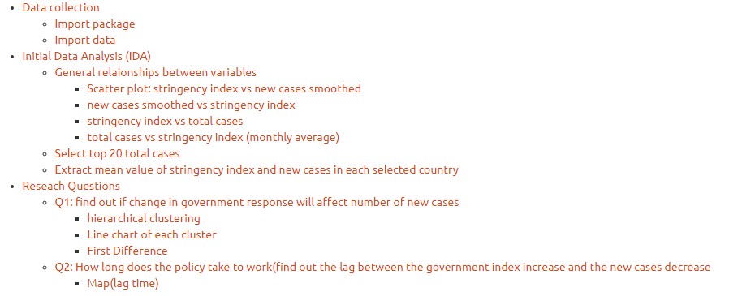
Figure 1: Schematic of the Project overview

Slide 26
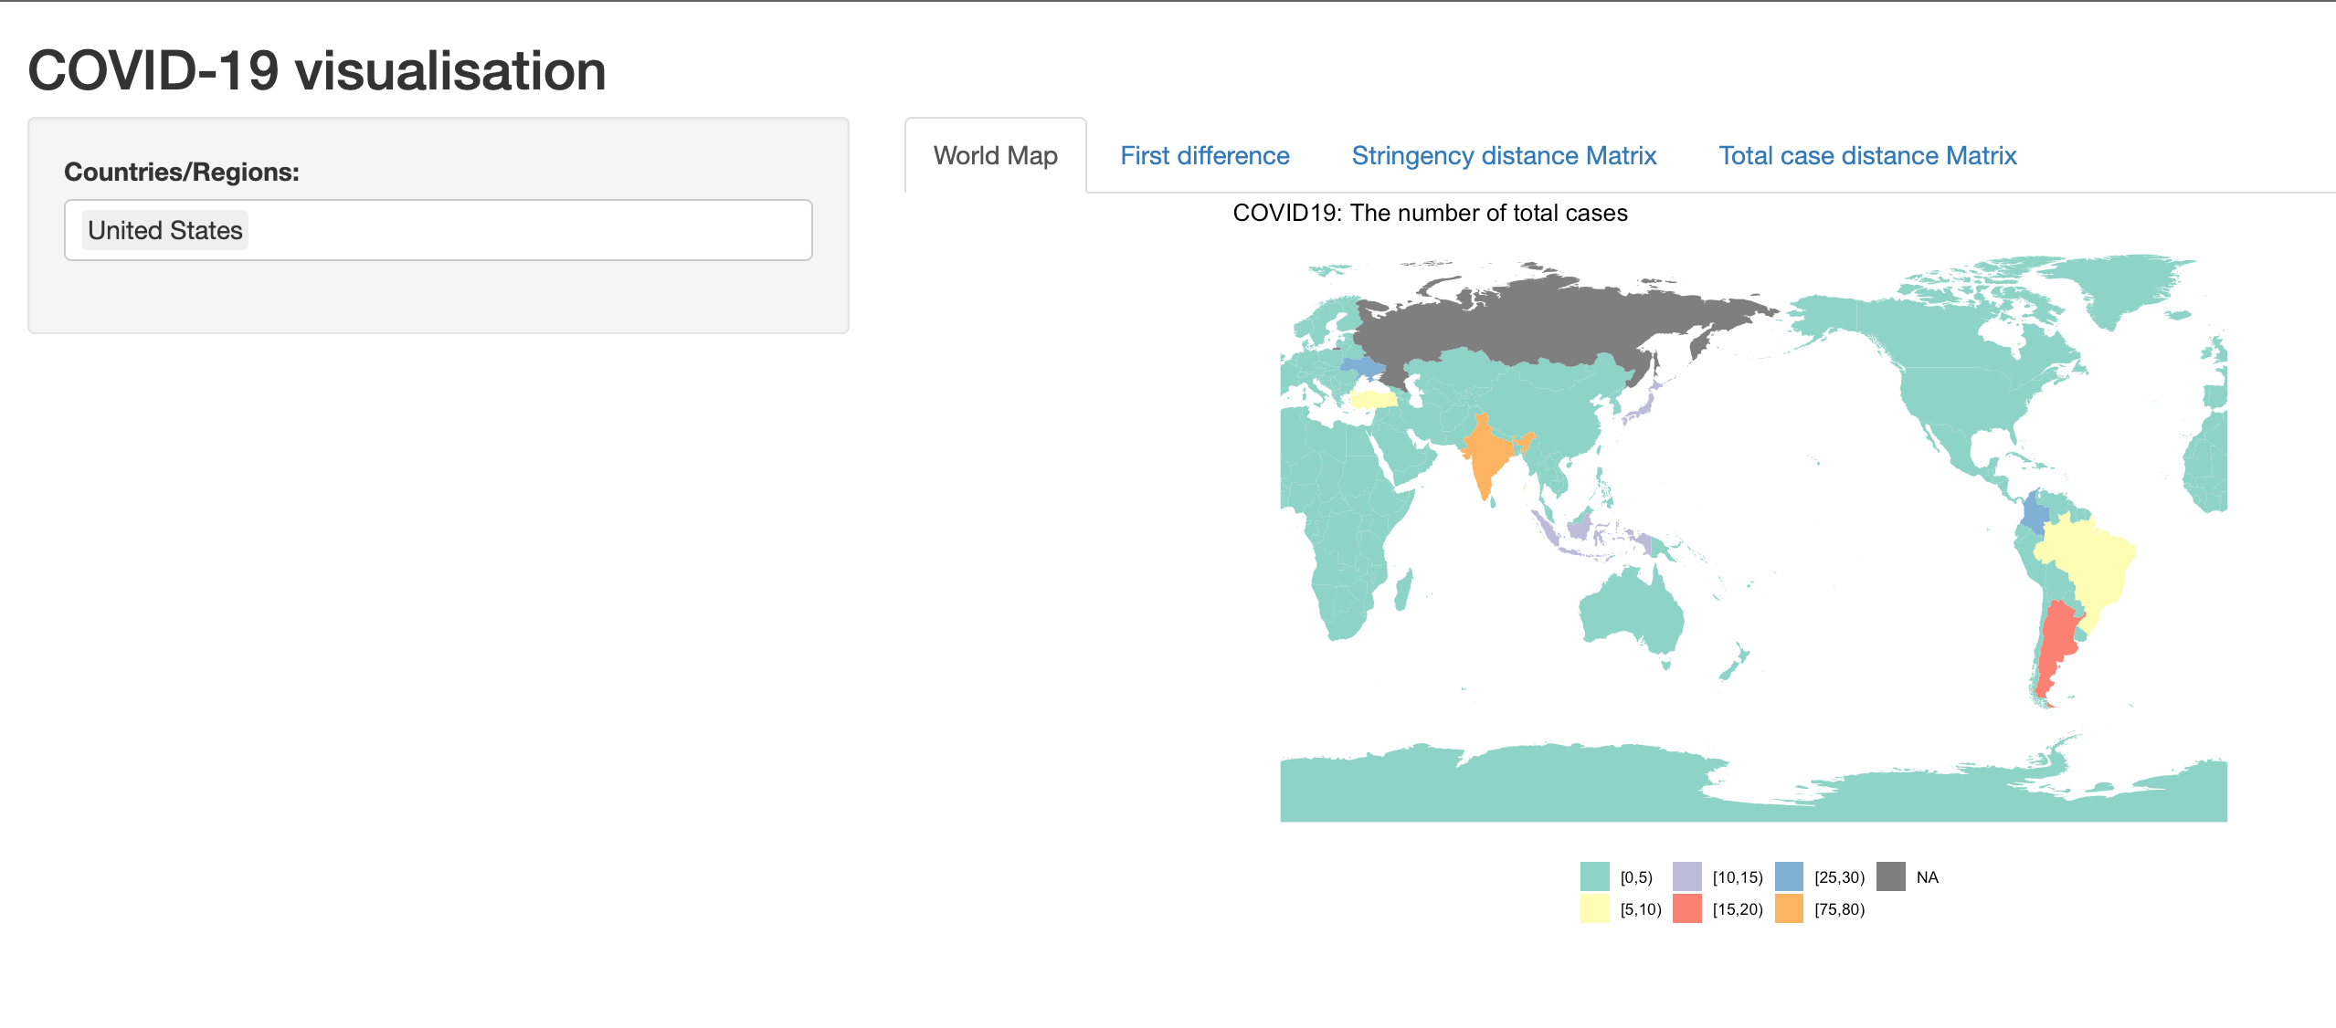
Figure 1: Schematic of the Project overview

Slide 27
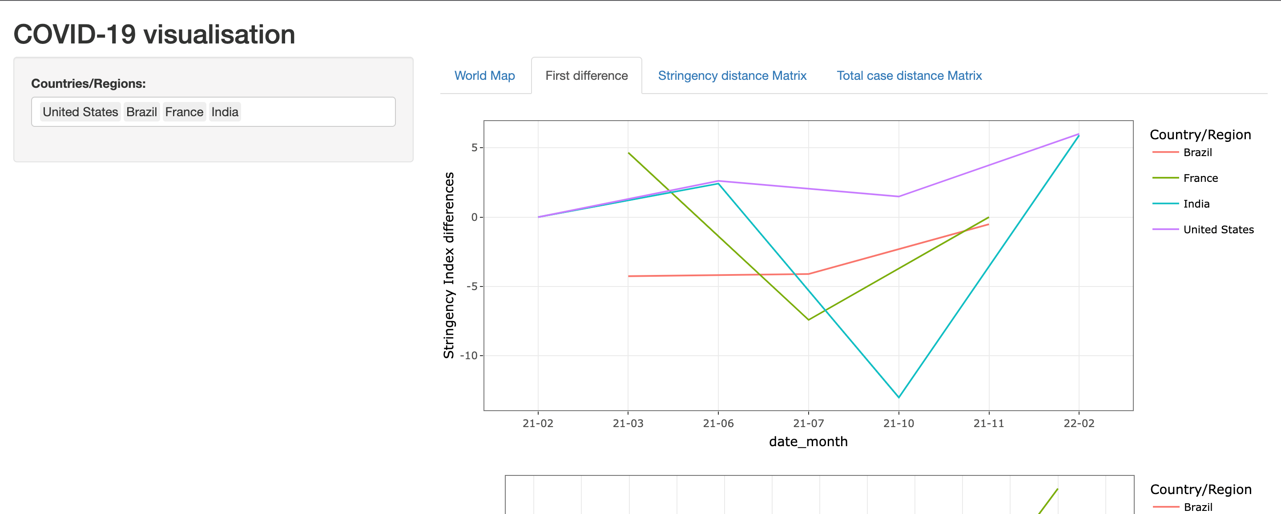
Figure 1: Schematic of the Project overview

Slide 28
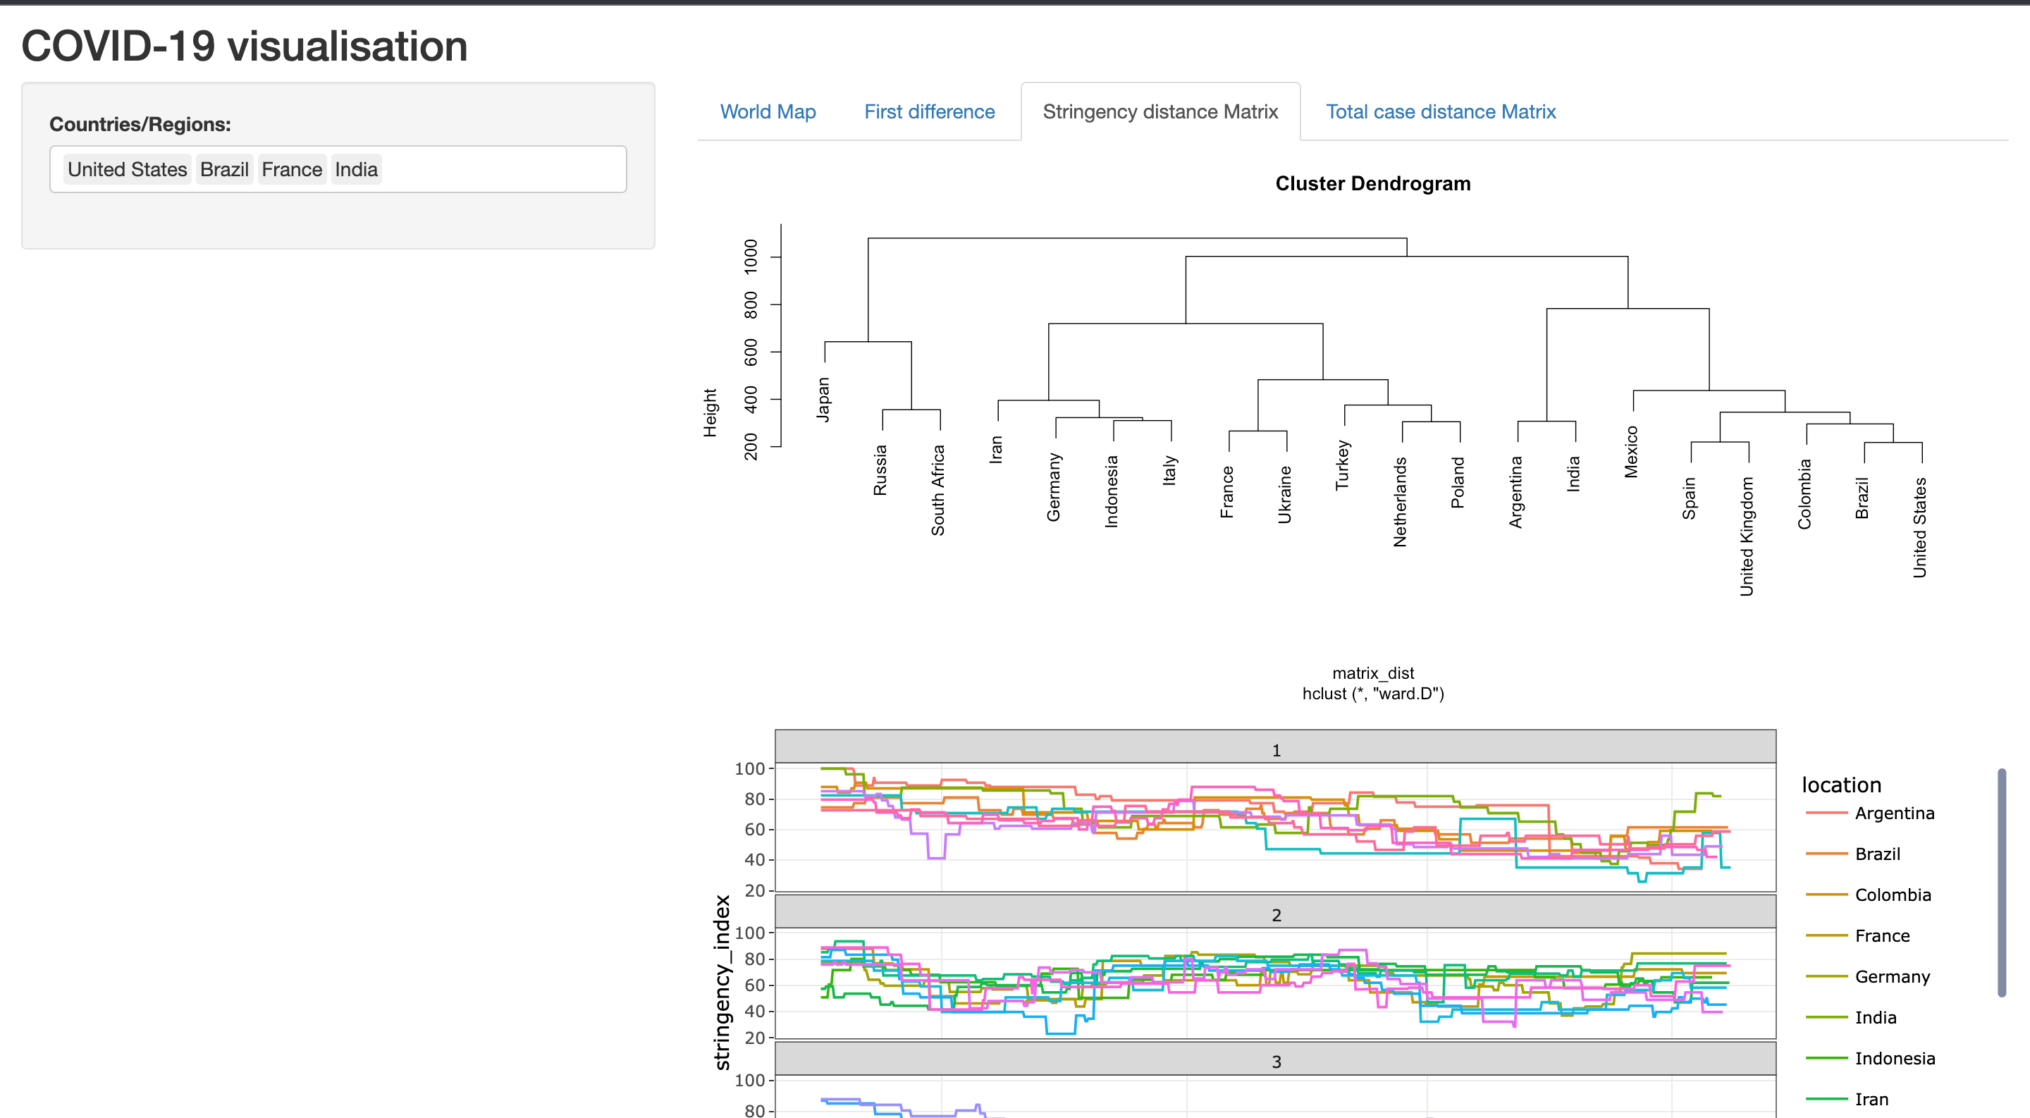
Figure 1: Schematic of the Project overview

Slide 29
Key results or message from the project / analysis
Results 1:
General trend:
The general trend obtained by scatter plot is that the stringency index increases with the increase of new cases, and the total death and total cases decrease with the increase of the government strictness index
Results 2: First of all, through the line chart of stringency_index of various countries, it can be seen that most countries have a relatively high state control and fluctuate up and down to varying degrees. Most countries already have a lower level of control in early 2022 than before, though it is likely to rise as new cases increase. As can be seen from the line chart of new cases in most countries, the range of new cases in some countries is smaller by comparison, and the range of new cases fluctuates from January 2022 onwards. Some countries continue to increase on a small scale. But in two countries (India and the US) the change is more pronounced.
Results 3:
From the map, we can find that the lag time in Russia, India, Colombia, and Ukraine are relatively large, indicating that the time interval between the increase in the stringency index and the decrease in the number of new cases smoothed in these countries is relatively long. Though the results, it is found that the policies may have effects on decreasing the new cases smoothed, but it may takes more time in these countries for new cases smoothed to begin to decline.

Slide 30
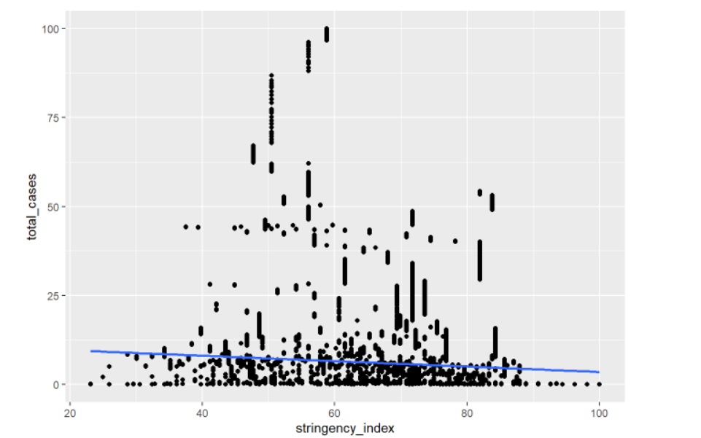
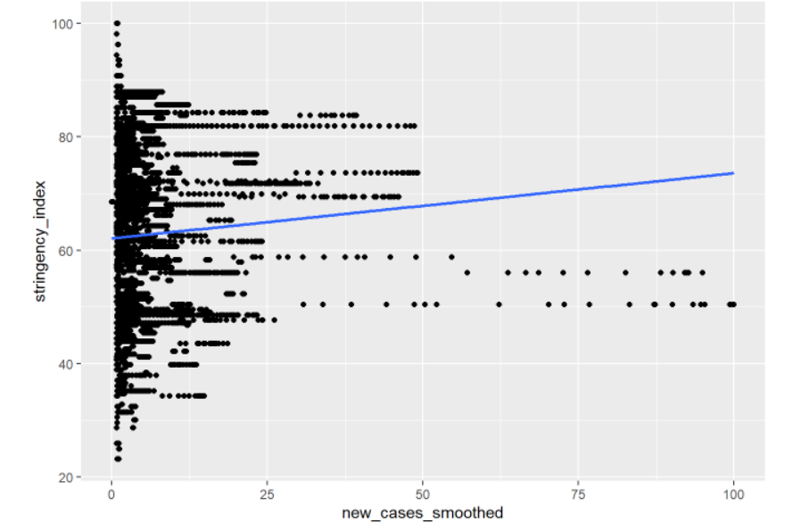
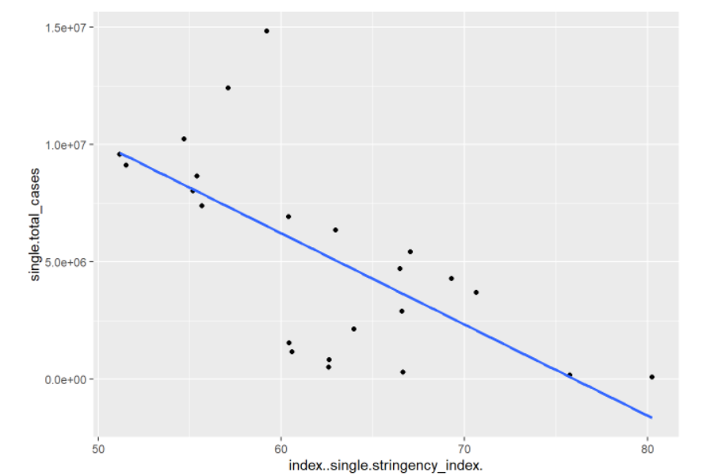
Draft or final evaluation
General relationship:
stringency index vs total cases
new cases smoothed vs stringency index
average stringency index
vs
average total cases

Slide 31
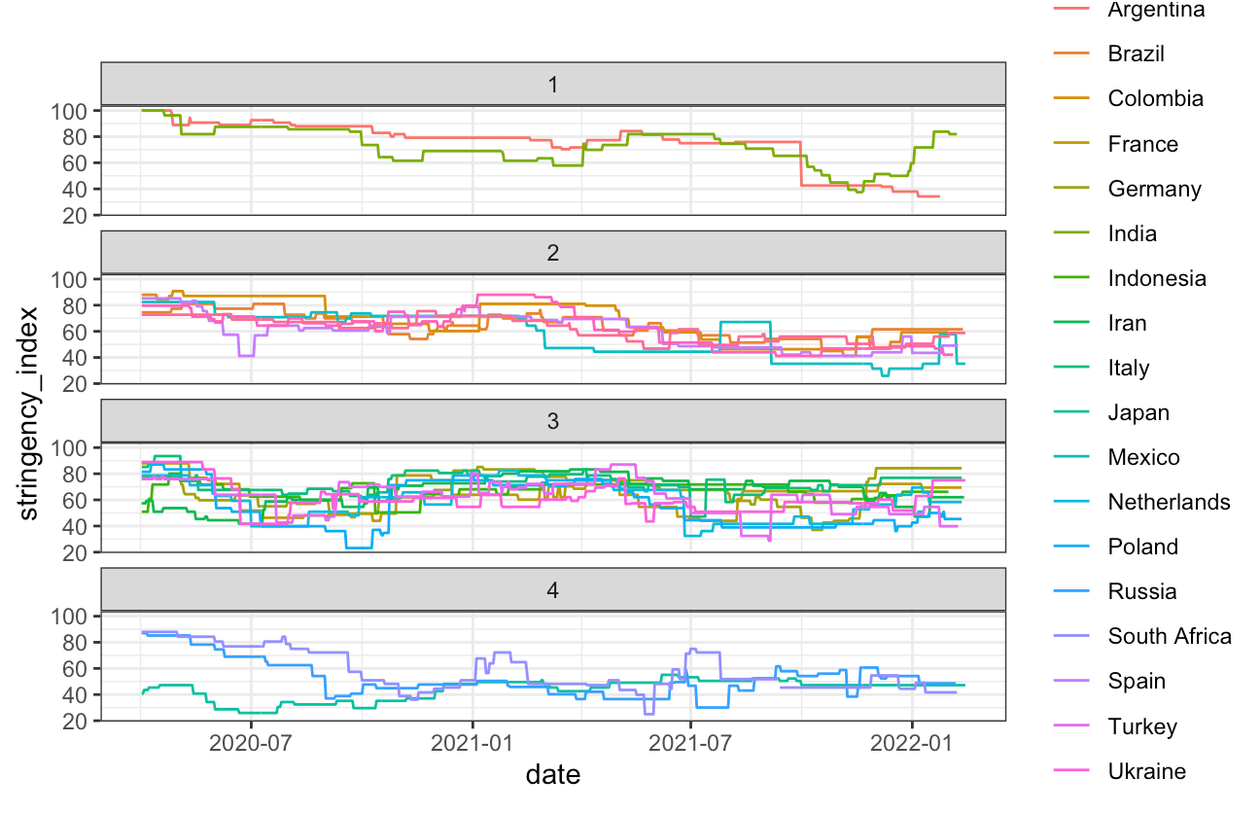
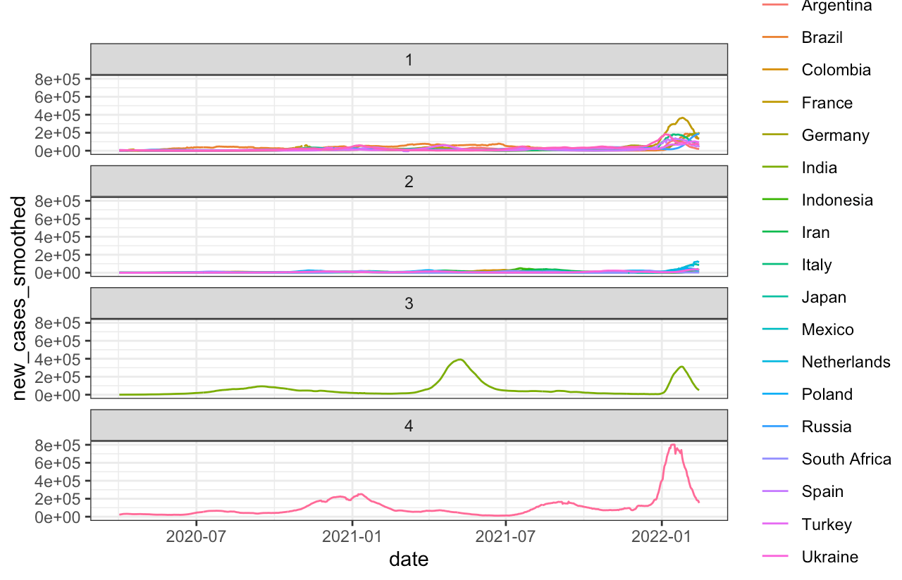
Draft or final evaluation
Clustering and Line Chart

Slide 32
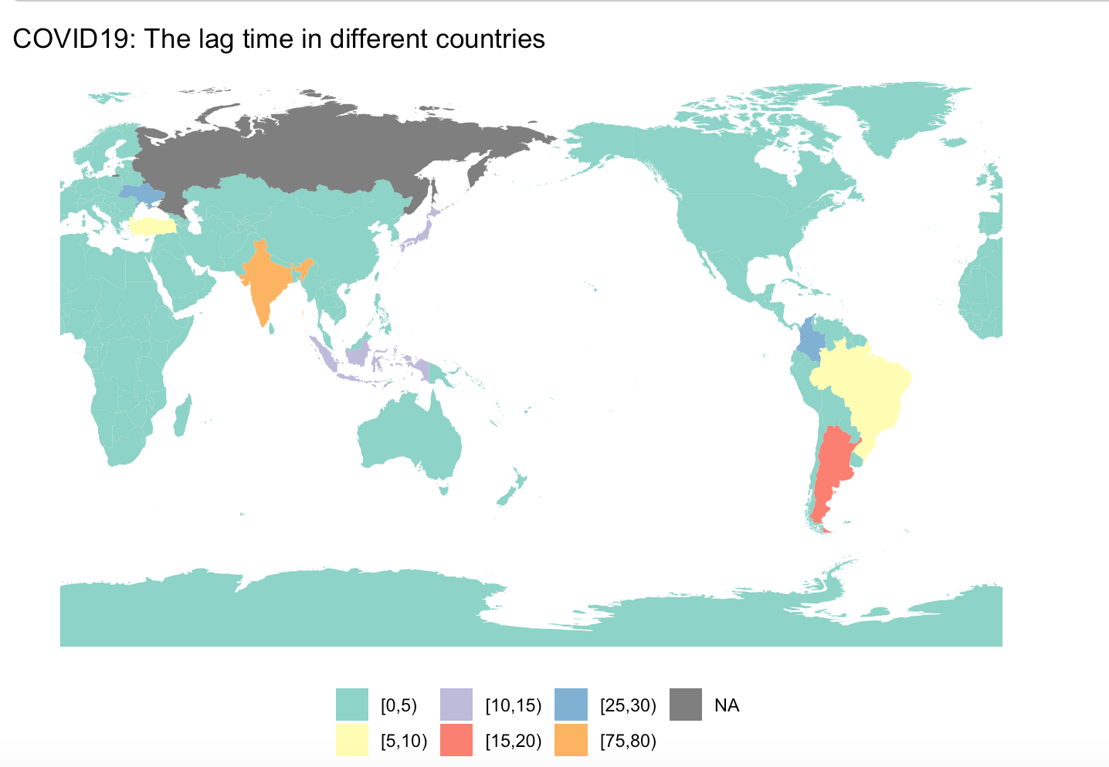
Draft or final evaluation
Lag Map

Slide 33
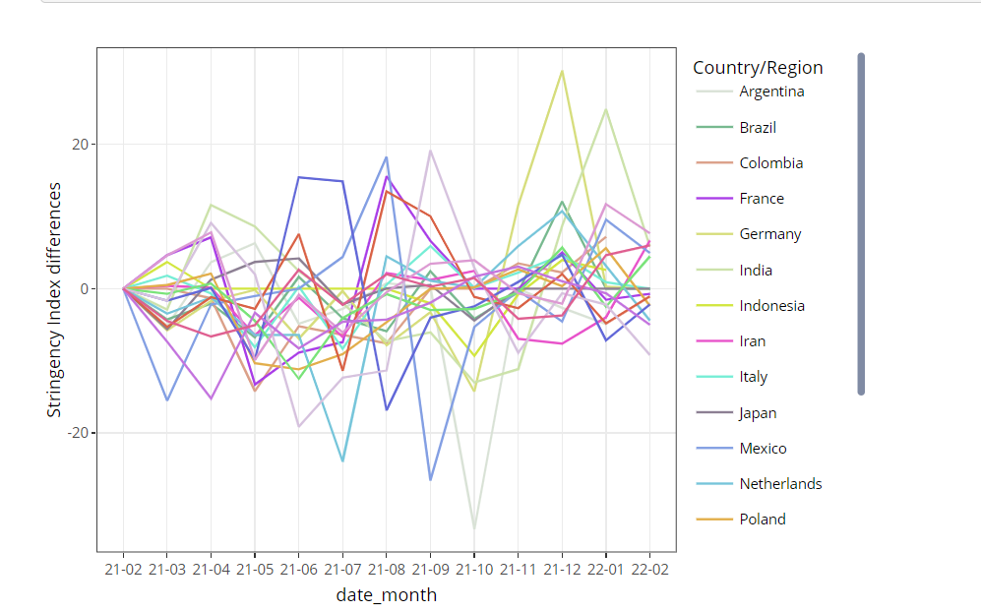
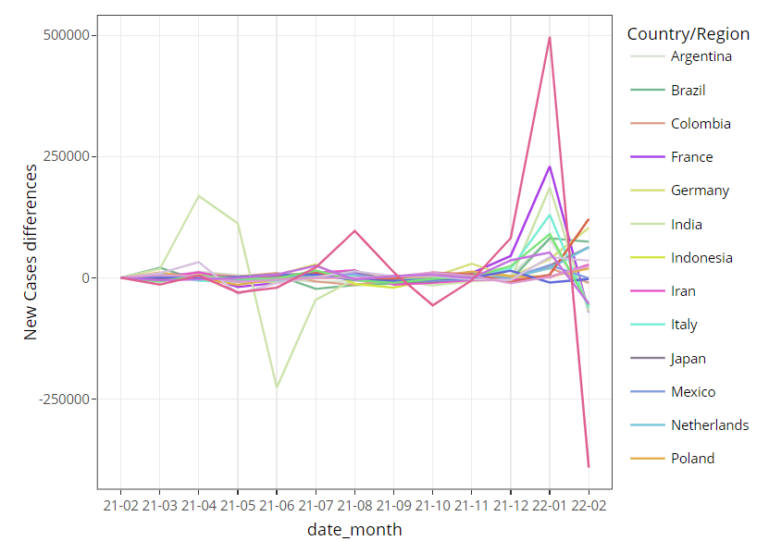
Draft or final evaluation
First Difference:

Slide 34
Meeting minutes
Date and time of meeting: 25/04/2022, 26/04/2022, 27/04/2022, 28/04/2022, 30/04/2022, 01/05/2022 (at least 1.5 hours of each meeting)
Team members present: all members
AGENDA
Item | Discussion (you can refer to previous slides) | Actions (who) – action points for next week
compare two FD figures | Compare the FD figure of stringency index and new cases smoothed to find the relationship | try to combine the two figures or combine the turnning points ---Yunshuo Zhang, Fu Kang
find the mean lag time | Calculate the mean value of the lag time of each country | display the mean lag time on the map --- Katherine An
line chart with month data | Find the trend of stringency index and new cases smoothed over months | find the trend over months ---Yachao Zhang
summarise and analyse results | Summarise all the result and analyse the result based on the questions | Summarise and analyse the currently result ---Yuxuan Qin
perfect the shiny | combine the result figure on the shiny and update shiny | Put our new figures to the shiny and update it according to the tutors’ suggestions ---Yuxuan Qin
Next meeting date and time: 03/05/2022
Group member responsible for finalising/submitting minutes: Yunshuo Zhang
To be posted on the CANVAS Individual group website

Slide 35
Progress and action points
Action points from last week … …
discuss lag map
data clean
fix figures
Key progress over last week …
discuss the code of the lag map
clean the oxford data set to get the coefficients changes of the index
use the hierarchical clustering to divide the countries into groups and draw the line chart of stringency index and total new cases of each change of stringency index for the oxford data
find the first difference for the oxford data

Slide 36
Define your project – What is your question/product
Project: find out if government responses to covid is effective
Question 1: Identify the top 20 countries with the most total cases as our research object.
Question 2: find out if change in government response will affect number of new cases
Question 3: How long does the policy take to work(find out the lag between the government index increase and the new cases decrease.

Slide 37
Define your project – who is your target audience
Explore different types of target audience and its relationship to your project and select
the most appropriate.
Target audience | Characteristics of target audience | How does it impact your project
policy-making organizations in countries with serious epidemic and researchers who manage policies during the epidemic | They are key people responsible for policy formulation and research | The increase and decrease of restrictive items in their policies have a great impact on the increase of cases

Slide 38
Figure 1: Schematic of the Project overview

Slide 39
Figure 1: Schematic of the Project overview

Slide 40
Figure 1: Schematic of the Project overview

Slide 41
Figure 1: Schematic of the Project overview

Slide 42
Key results or message from the project / analysis
Results 1:
As you can see from the line chart of the total new cases, India has the highest number of all countries, and it fluctuates wildly. The United States also has the second highest number of total new cases. Other countries are not very different.
It can be seen from the line chart of the strict control index that although all countries have drastic fluctuations in the control degree, the overall trend is declining. It can also be seen that with the improvement of the epidemic, the national control is not so strict.
By comparing the cluster line chart, it can be seen that the degree of strict control of all countries can be roughly divided into four categories, among which the United States and India are in a cluster. However, it can be seen from the cluster line chart of the total number of new cases that the case trends are different between the two countries, indicating that roughly the same level of control does not apply to the two countries with different situations. Although India showed an increasing trend from April to May 2021, the total number of new cases dropped sharply and returned to a relatively flat trend through policy control, indicating that the policy was effective.
For the United States, the total number of new cases has been fluctuating, indicating that the government's strict control policy has not achieved good results. Therefore, the United States should formulate corresponding countermeasures according to the case situation of its own country, at least different from other countries.

Slide 43
Key results or message from the project / analysis
Results 2:
The map shows the lag time of different countries between 2021-01-01 and 2021-12-31. From the map, we can find that when all countries increase the stringency index, there will be a certain decline in new cases smoothed, which shows that some measures introduced by the government against COVID-19 are effective. In addition, it also can be found that the colors of certain countries or regions are significantly different from other countries or regions, such as India and Poland. The lag time of these countries is relatively larger than the lag time of other countries, which indicates that the time interval between the increase in the stringency index and the decrease in the number of new cases smoothed in these countries is relatively long. Thus, we can infer that some of the government's measures against COVID-19 may take longer to take effect in these countries. Target audiences can compare the specific measures of these countries with larger lag times to those of countries with smaller lag times and observe which measures may help to smooth the decline of new cases. And they can refer to their own country's policies and revise and improve them according to their own country's national conditions.
Results 3:
By observing the new caeses FD chart, it is found that the changes in India and the United States fluctuate greatly. Combined with the stringency index FD figures, it is found that the policies are also changing in the 2021, indicating that these countries have not found policies suitable for their own countries to fight the epidemic and can not well limit the epidemic

Slide 44
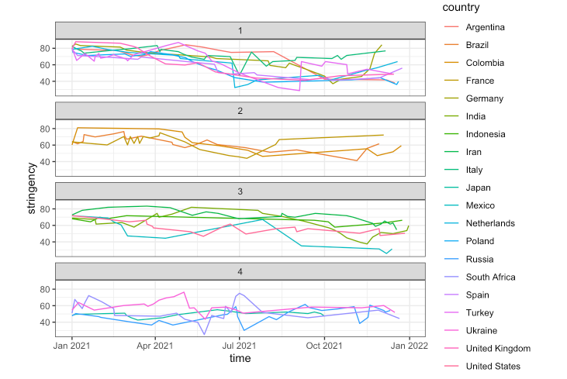
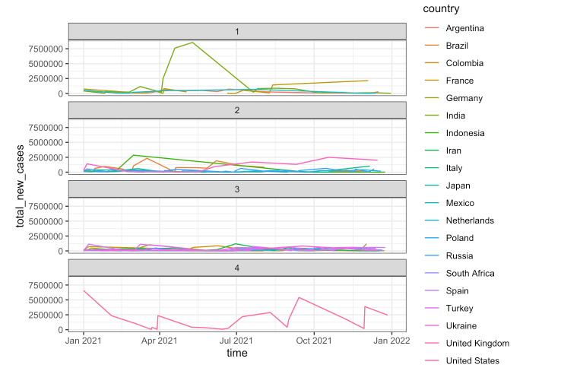
Draft or final evaluation
Clustering and Line Chart

Slide 45
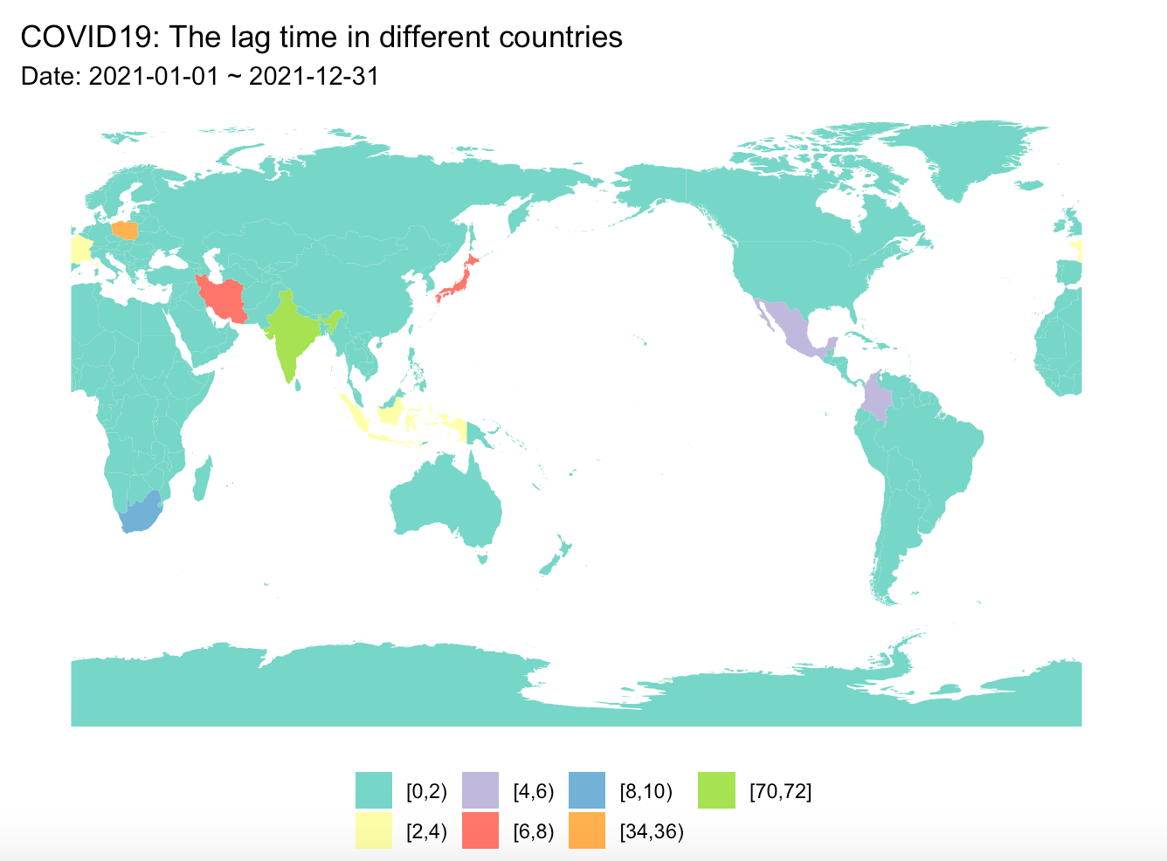
Draft or final evaluation
Lag Map

Slide 46
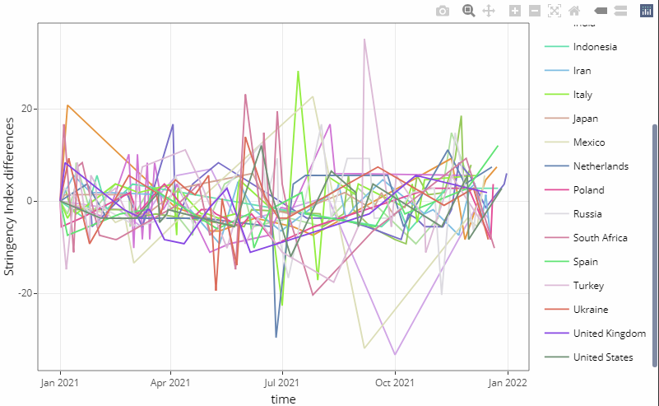
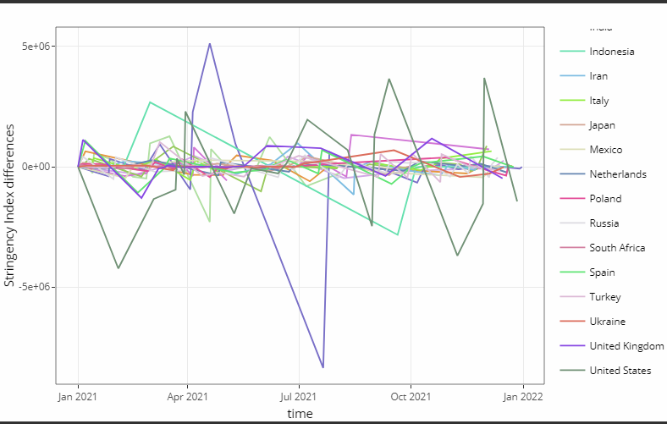
Draft or final evaluation
First Difference:

Slide 47
Meeting minutes
Date and time of meeting: 03/05/2022,08/05/2022 (at least 2 hours of each meeting)
Team members present: all members
AGENDA
Item | Discussion (you can refer to previous slides) | Actions (who) – action points for next week
Organize report | Organize all the code the analyze result | Sort out all the code and analysis, and complete the preliminary report model ---Fu Kang
find the max lag time | Fix the code and get the max lag time of each country | display the max lag time on the map --- Katherine An
Compare the coefficient that line chart change | Find the specific coefficientchange in the stringency index | find the specific coeficients change and which coefficient would affect the covid better ---Yunshuo Zhang
summarise and analyse results | Summarise all the result and analyse the result based on the questions | Summarise and analyse the new result ---Yachao Zhang
perfect the shiny | combine the result figure on the shiny and update shiny | Put our new figures to the shiny and update it according to the tutors’ suggestions ---Yuxuan Qin
Next meeting date and time: 10/05/2022
Group member responsible for finalising/submitting minutes: Yunshuo Zhang
To be posted on the CANVAS Individual group website

Slide 48
Draft of the presentation outline
Key message of the presentations.
data selection
stringency and new cases changing trend of each country
policy lag time and efficiency
Structure of the presentation
Introduction
Data Clean
Research Question 1—Hierarchical clustering+FD
Research Question 2—Lag Map + Variable analyze
Shiny
Conclusion

Slide 49
Final results or messages from the project / analysis
Results 1: Trend result:
By comparing the degree of stringency index and the total new cases in the selected countries, it can be seen that countries with severe fluctuations in control policies will have a relatively small increase in new cases, such as Russia and Mexico. On the contrary, if the stringency index of some countries are relatively flat, it indicates that the corresponding countermeasures are not formulated according to the increase of new cases, resulting in the large fluctuation of the increase of new cases, such as the United States, Spain and United Kingdom.
Results 2: FD result:
By observing the new caeses FD chart, it is found that the changes in India and the United States fluctuate greatly. Combined with the stringency index FD figures, it is found that the policies are also changing in the 2021, indicating that these countries have not found policies suitable for their own countries to fight the epidemic and can not well limit the epidemic

Slide 50
Final results or messages from the project / analysis
Results 3: LagMap result:
From the map, we can find that the max lag time in Philippines, Indonesia, UK, Iran and India are relatively large, indicating that the policies may have effects on decreasing the new cases , but it may take more time in these countries for new to begin to decline. However, in South Africa, France and Italy, they may use shorter time to decrease new cases after stringency index increasing.
Based on the policy levels change, when policy makers want to formulate some policies that will help the number of new cases drop, they can increase the change of each policy index larger, such as: closing schools from 1 to 3, and closing workplaces from 1 to 1 to 3 and so on.

Slide 51
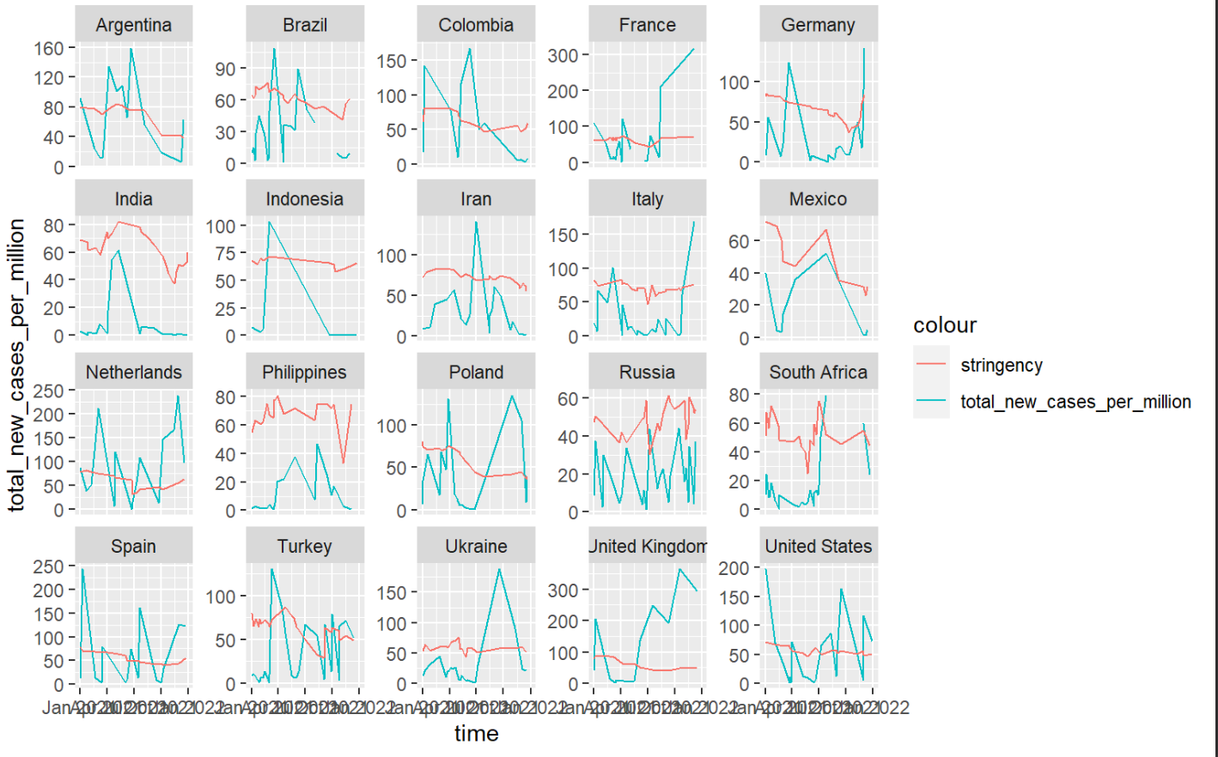
Replace this with TWO key figures for your presentations
Excluding
Figure 1

Slide 52
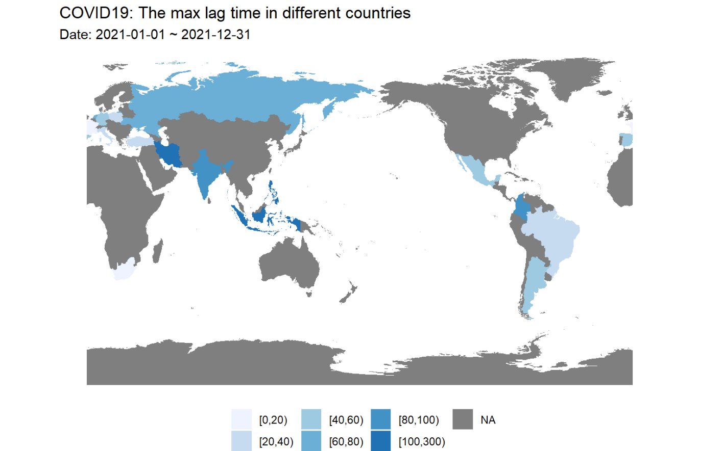
Replace this with TWO key figures for your presentations
Excluding Figure 1

Slide 53
Plan for demonstration
Prerecording ?
Scaffold of the demonstration.
Introduction
- data set description + variables description
Data Clean
- covid data clean + oxford data clean
Research Question 1:
- Line Chart + Hierarchical Clusterinh + First Difference
Research Question 2:
- lag map + variable change
Shiny
Conclusion

Slide 54
Meeting minutes
Date and time of meeting:15/5/2022
Team members present: All Members
AGENDA
Item | Discussion (you can refer to previous slides) | Actions (who) – action points for next week
Analyse Q1 trend result | Analyze the Q1 based on the Line chart, Hierarchical cluster and First difference | Analyze ans summarise the result of all the figures in the Q1 ---Yachao Zhang
Analyse Q2 lag map result | Analyze the Q2 based on the lag map and variable change of stringency index | Analyze ans summarise the result of map and dat in the Q2 ---Katherine An
Format presentation PPT | prepare the content of the presentation and combine to format a completed PPT | Organize the formation and content of the PPT ---Kang Fu
Format draft of report | format the draft of the report | Organize the formation and content of the Report ---Yunshuo Zhang
perfect shiny | combine the result figure on the shiny and update shiny | Put our new figures to the shiny and update it according to the tutors’ suggestions ---Yuxuan Qin
Next meeting date and time: 18/5/2022
Group member responsible for finalising/submitting minutes:Yunshuo Zhang
To be posted on the CANVAS Individual group website

